Slide 1
Volcanic ash impingement
PROVIDA
University of Surrey
Prof. Sai Gu, Zihang Zhu
7/JUN/2016

Slide 2
Content
Recap of Previous work
Improvement of VA injection model
Modeling high viscosity droplet impact
Conclusion and Next step

Slide 3
Recap of previous work
Modeling 2D in-flight VA particle and phase transition
Chamber environment
Wall of tube
outlet
PS gas inlet

Slide 4
Recap of previous work
Modeling 2D in-flight VA particle and phase transition

Slide 5
Recap of previous work
Modeling 2D in-flight VA particle and phase transition

Slide 6
Recap of previous work
Single particle impact (VOF)
Viscosity 1 Pas (2 days)

Slide 7
Recap of previous work
Single particle impact (CEL)
Viscosity 1 Pas (~ 1 day)

Slide 8
Recap of previous work
Temperature and composition dependent viscosity*
log η (Pa s)
Temperature (°C)
*Giordano D, Russell JK, & Dingwell DB. Silicate Melt Viscosity Calculator. 2008.

Slide 9
Recap of previous work
Liquid spray/Nozzle test
Water pump
Atomizer
Air cylinder
Mean: 22.814 μm
Mean: 22.623 μm

Slide 10
Recap of previous work
Liquid spray/Nozzle test

Slide 11
Recap of previous work
Problems
The 3D swirl effect of the VPS is not taken into consideration. This makes the temperature field only at the centre of the plasma jet matches the experiment data.
The CEL, VOF particle impact model is not suitable for the high-viscosity flow due to high demand of computational resources.

Slide 12
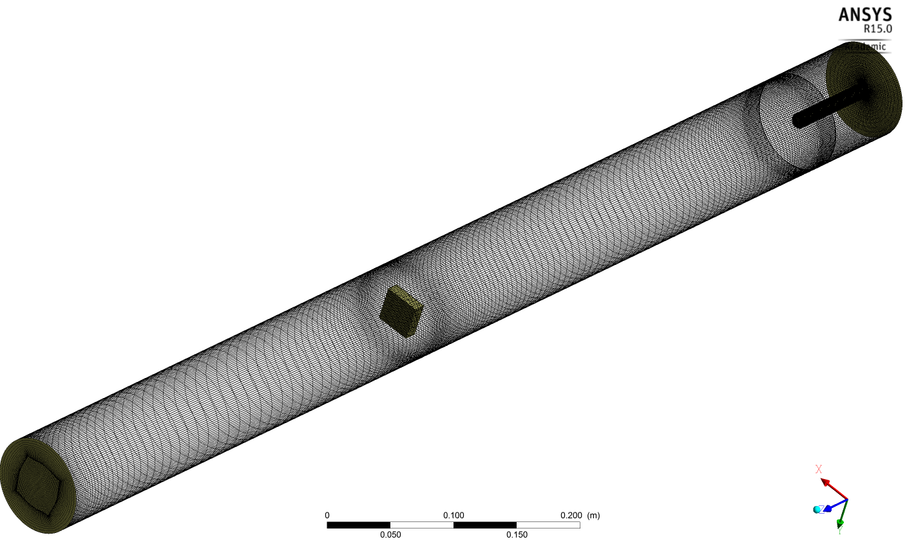
Improvement of VA injection model
3D model

Slide 13
Improvement of VA injection model
CFD vs Experiment data (Temperature)

Slide 14
Improvement of VA injection model
CFD vs Experiment data (Velocity)

Slide 15
Improvement of VA injection model
CFD vs Experiment data (Velocity with substrate)

Slide 16
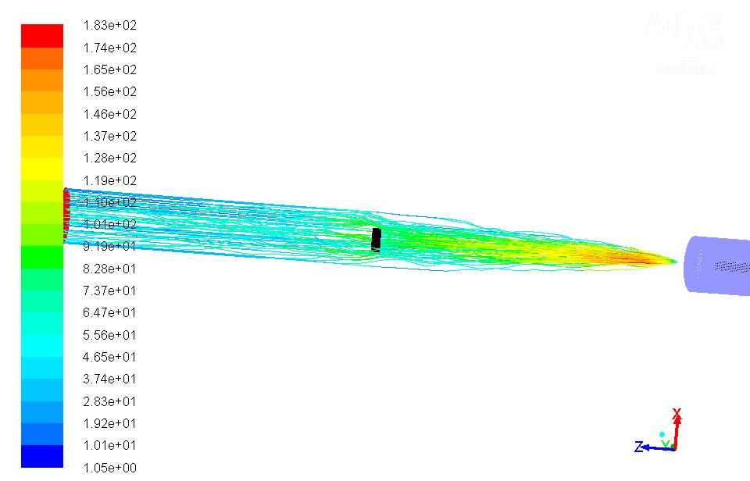
Improvement of VA injection model
DPM model

Slide 17
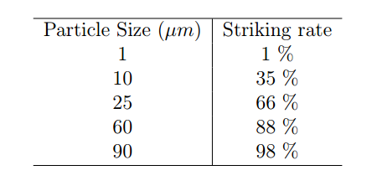
Improvement of VA injection model
Striking rate and contact angle
Large particles
Normal impact
Oblique impact ( small contact angle)
Small particles
Bypass the substrate
Oblique impact (large contact angle)

Slide 18
Improvement of VA injection model
Phase transition and in-flight particle heat transfer

Slide 19
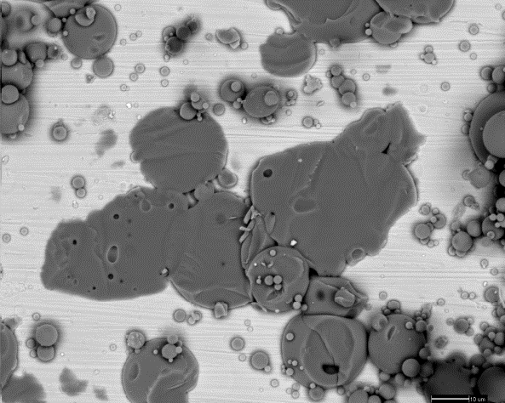
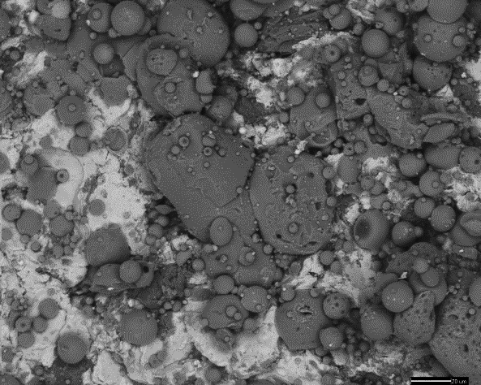
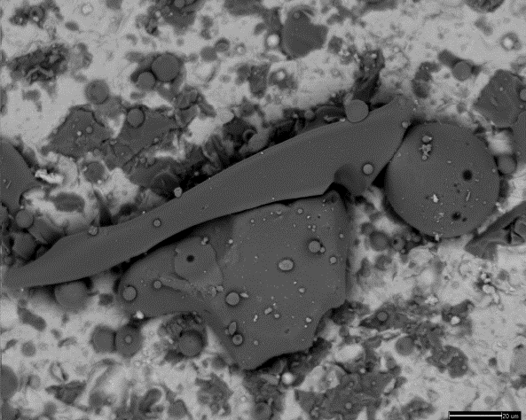
Improvement of VA injection model
Phase transition and in-flight particle heat transfer

Slide 20
Modeling high viscosity droplet impact
Temperature and composition dependent viscosity*
log η (Pa s)
Temperature (°C)
*Giordano D, Russell JK, & Dingwell DB. Silicate Melt Viscosity Calculator. 2008.

Slide 21
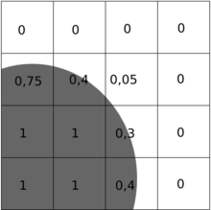
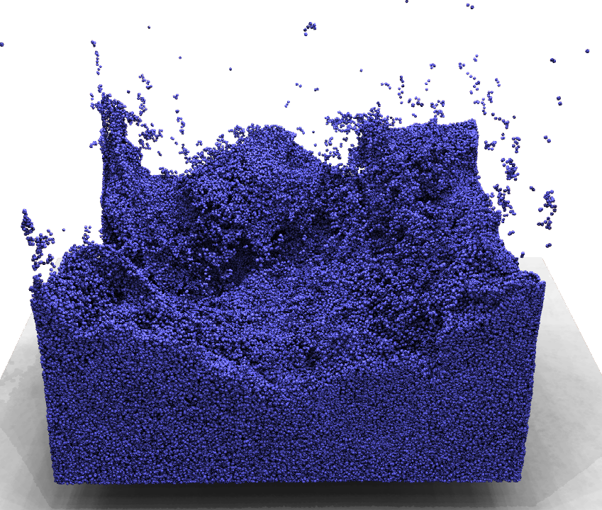
Modeling high viscosity droplet impact
Particle based SPH method (smoothed particle hydrodynamics)
Eulerian Mesh (VOF)
High computational resource consumption
Lagrangian Particles (SPH)
By using different discretization/ interpolation method, SPH is faster then traditional VOF method
Have stability issue

Slide 22
Modeling high viscosity droplet impact
SPH method (algorithm - density)
Any function A(r) could be represented by
If it’s interpolated by particles of mass m and density ρ
Where W is called the kernel function, h is the smoothed radius.
For example, the density ρ at each particle could be represented by

Slide 23
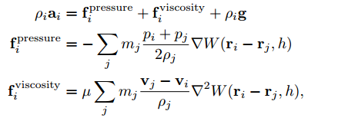
Modeling high viscosity droplet impact
SPH method (algorithm -EOM)
There fore the N-S governing equation is then:
The surface of the substrate is set with damping and elasticity.

Slide 24
Modeling high viscosity droplet impact
SPH method (algorithm –heat transfer)
The heat transfer equation could be represented:
Where
Ghost particles was generated to simulate only the heat transfer between the substrate and droplet. They will not have any influence on the equation of motion.

Slide 25
Modeling high viscosity droplet impact
Density stability

Slide 26
Modeling high viscosity droplet impact
Viscosity 1 Pas and no solidification

Slide 27
Modeling high viscosity droplet impact
Heat transfer

Slide 28
Modeling high viscosity droplet impact
Viscosity 1 Pas velocity 10 m/s normal impact
Spreading Factor 1.5

Slide 29
Modeling high viscosity droplet impact
Viscosity 10 Pas velocity 10 m/s normal impact
Spreading Factor 1.1

Slide 30
Modeling high viscosity droplet impact
Viscosity 50 Pas velocity 10 m/s normal impact
Spreading Factor 1.05

Slide 31
Modeling high viscosity droplet impact
Viscosity 50 Pas velocity 20 m/s oblique impact (30°)
Spreading Factor 1.1

Slide 32
Modeling high viscosity droplet impact
Viscosity 50 Pas velocity 20 m/s oblique impact (45°)
Spreading Factor 1.5

Slide 33
Modeling high viscosity droplet impact
Viscosity 50 Pas velocity 20 m/s oblique impact (60°)
Spreading Factor 1.7

Slide 34
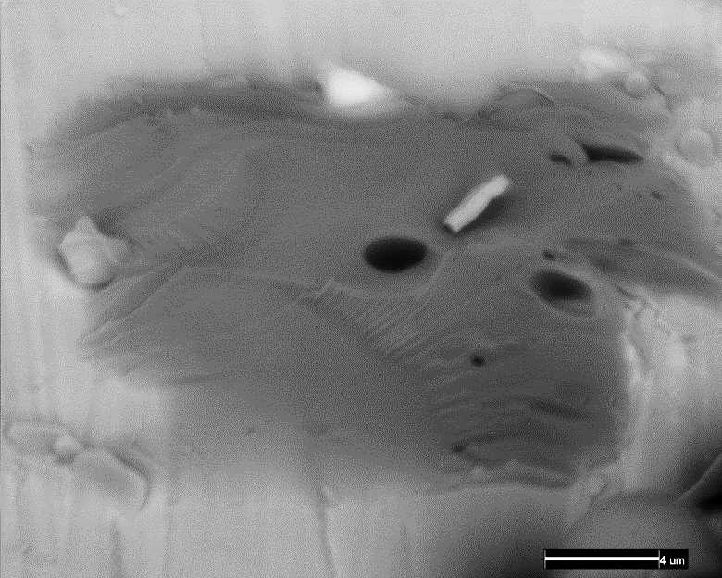
Modeling high viscosity droplet impact

Slide 35
Conclusion and Next step
Viscoelastic (VE) model could be more proper in case of simulating the particles.
The SPH EOM could be switched to SPH VE constitutive equations.

Slide 36
Thank you !

