Slide 1

Exploring Solution Plasma Sprayed Coating Architectures for CMAS Resistance

Slide 2
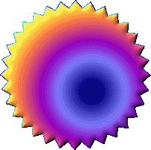
Solution plasma spraying: Why should it capture our imagination?
Significant problems with feeding fine powders are obviated
A fair bit is now “known”, but much is still in the realm of conjecture / mystery … so vast areas remain to be explored
It is very inter-disciplinary, e.g., chemistry inputs especially vital, than at any other time in thermal spray history
Novel coating chemistries conveniently possible
There can be life beyond TBCs for solution plasma spraying … relevant for many other applications

Slide 3
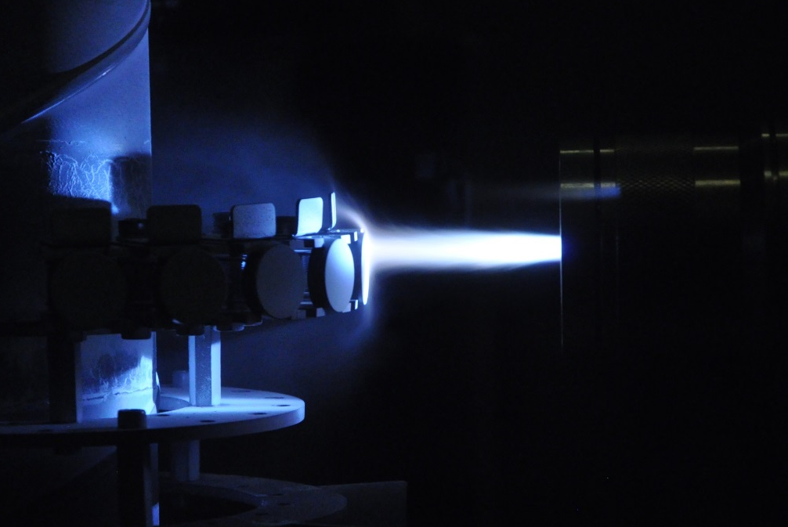
Why now ?
Axial feed, high power plasma spray systems are game changers
Axial Injection
Radial Injection
Injection into the centre of the plasma, coaxial to plasma flow
Less sensitive to suspension properties and injection parameters
Injection in plasma plume periphery, 60°-90° to flow
Injection parameters require tuning and are sensitive to suspension parameters
Axial feeding particularly ideal for solution feedstock; more effective utilization of plasma energy, capable of better addressing concerns of reduced productivity

Slide 4
Deposition Efficiency: SPS vs. SPPS,
effect of plasma power & spray distance
M.Marr et al., J. Power Sources, 245 (2014) 398
Many interesting observations:
High deposition efficiencies achievable with solution-based precursors
Plasma power & spray distance can play a dominant role
Particularly in case of solution precurors – beyond certain threshold power level, DE for solution precursors can be attractive
Dramatic drop in DE at very high spray distance indicative of resolidification prior to impact

Slide 5
Axial Suspension Plasma Sprayed
Gadolinium Zirconate-based TBCs for Combating CMAS Attack

Slide 6

Why Gadolinium Zirconate?
Lower thermal conductivity than YSZ
Excellent phase stability
Better CMAS attack resistance than YSZ
Why Double layer GZ/YSZ?
GZ has a lower fracture toughness than the conventionally used 8YSZ
GZ also reported to react with alumina (TGO) at high temperature, leading to formation of GdAlO₃
Therefore, GZ/YSZ double layered TBCs with 8YSZ as the intermediate layer appears more promising
Vassen et al. ‘Overview on advanced thermal barrier coatings’ Surf. Coat. Technol., Vol. 205, 2010

Slide 7
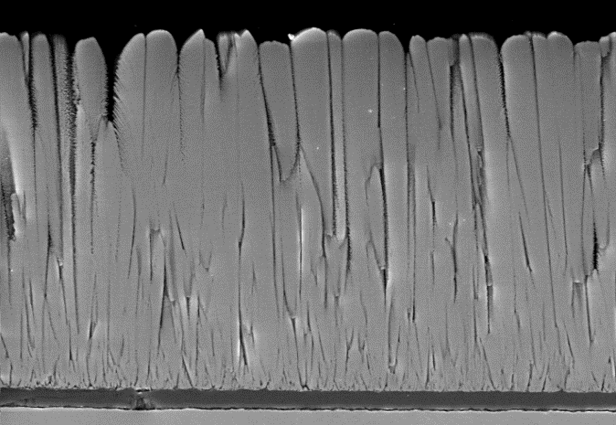
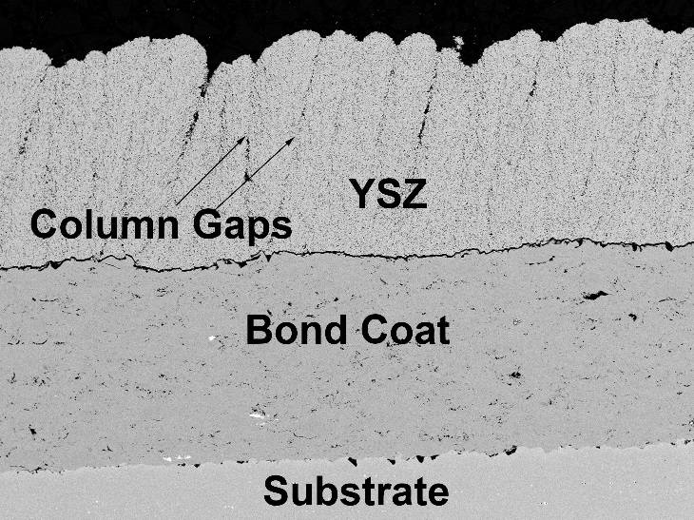
Why Suspension Plasma Spray (SPS)???
Low thermal conductivity
High strain tolerance
Courtesy, N. Curry et al, University west
Courtesy, N.P. Padture et al, Ohio State university
APS Microstructure
EB-PVD Microstructure
SPS mimics EB-PVD to generate a columnar microstructure and also yields a lower thermal conductivity
Courtesy, S. Mahade et al., 2015, University West
SPS Microstructure

Slide 8
Suspension plasma spraying (liquid feedstock)
Process Characteristics
Feedstock | Suspension (Liquid feedstock)
Powder particle size | Finer ( < 1µm)
Coating microstructure | Fine structured & Columnar (can be altered based on parameters)
Schematic of the axial SPS process
Cross sectional SEM micrograph of SPS deposited TBC

Slide 9
Improve Erosion resistance
Improve CMAS infiltration resistance
Coating architectures investigated

Slide 10
Columnar microstructures could be generated in both single and double layer TBCs
Single layer YSZ a)Cross section b) Top view
Double layer GZ/YSZ a)Cross section b) Top view

Slide 11
Relatively dense top layer through suitable spray parameter control (different D₅₀ of the solute)
Triple layer GZdense/GZ/YSZ a) Cross section b) Top view

Slide 12
Ash
1 wt.% Hekla, YSZ single layer
YSZ single layer TBC showed no horizontal cracks upon exposure to Hekla ash
However, infiltration (?) through the intercolumnar spacing is feared and prospects for long life with such a single-layer, columnar coating architecture did not appear encouraging

Slide 13
Horizontal crack
1 wt.% Hekla, GZ/YSZ double layer
GZ/YSZ double layer TBC showed horizontal cracks in the GZ layer close to the interface with YSZ
Reason for crack propagating through GZ layer instead of YSZ is due to the lower fracture toughness of GZ than YSZ (approximately double than GZ)
Further investigations need to be made to find the reason for the origin of horizontal crack in double layer TBC

Slide 14
Spallation of denser GZ
Horizontal crack
1 wt.% Hekla, GZdense/GZ/YSZ triple layer
GZ dense/GZ/YSZ triple layer TBC also showed horizontal cracks in the 2nd GZ layer, but closer to the columnar/dense GZ coatings’ interface
Further investigation ongoing to explain these observations
Also, repeat experiments and explore alternate coating architectures

Slide 15
GZ/YSZ
GZdense/GZ/YSZ
As sprayed TBCs exposed in ambient air at 1150ºC (No ash added on top)
With no ash, the TBCs did not show presence of any horizontal cracks, although the exposure time was much longer at an identical test temperature

Slide 16
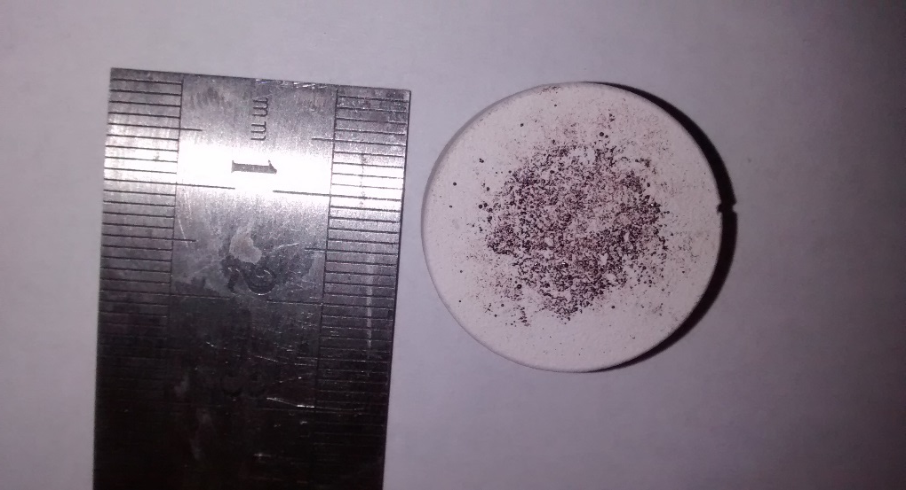
Alumina (APS) 60 µm
YSZ (SPS) 280 µm
Bond coat
Substrate
Al₂O₃/YSZ (60µm APS /280µm SPS)
Al₂O₃/YSZ, Hekla ash@1150ºC, 1 hour

Slide 17
60 µm thick alumina layer deposited by APS process on SPS deposited YSZ
Motivation to deposit the thin alumina layer by APS was to seal the columns formed in YSZ and beside providing additional protection
Ash
Alumina
YSZ
Vertical crack opening
1 wt.% Hekla @1150ºC , Al₂O₃/YSZ (60µm APS /280µm SPS)

Slide 18
Future Plans
CMAS test of the GZ based multilayered TBCs are planned under a burner rig … this work is being carried out in collaboration with FZ Julich, Germany
Explore different top coat compositions for added CMAS protection (yttria / YAG / alumina)
Evaluate different TBC “designs”

Slide 19
Improvements in
Gas Turbine Performance via
Novel Plasma Spray Coatings Offering Protection Against Ingested Species
Under
DST-EPSRC Research Initiative on Advanced Manufacturing

Slide 20
Choice of feedstock
Gd₂Zr₂O₇ coatings known to be effective against CMAS - form easy-to crystallize Ca₂Gd₈(SiO₄)₆O₂ apatite phase
Relatively lower ionic sized Y³⁺ based materials that favour formation of Ca₄RE₆(SiO₄)₆O make choice of Y₂Zr₂O₇ interesting
La₂Ce₂O₇ is stable @ 1400°C with low thermal conductivity (0.5‒1.02 W/mK at 1473 K), high CTE (12.3‒12.6 x 10⁻⁶/K at 573‒1473 K) than YSZ (2.1 W/mK, 10.5‒11.5 x 10⁻⁶/ K)
Addition of relatively smaller ionic radii, Gd³⁺ to La₂Ce₂O₇ to form (La_{1−x}Gd_{x})₂Ce₂O₇ is expected to accelerate crystallization of Ca₄RE₆(SiO₄)₆O phase and also reduce low temp CTE

Slide 21
Preparation of feedstock for APS & SPPS
Thermal spray grade Gd₂Zr₂O₇ powders are available as proprietary; Y₂Zr₂O₇ is also a commercially available TS grade powder
La₂Ce₂O₇ and (La_{1−x}Gd_{x})₂Ce₂O₇ are not available as standard TS grades and were synthesized in-house through arc melting and solid state sintering, respectively
Coatings of similar chemistry can be generated through SPPS using formulated precursors

Slide 22

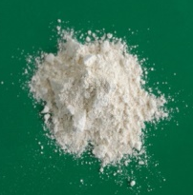
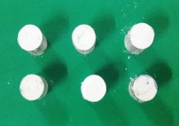
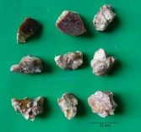
Synthesis of La₂Ce₂O₇ & La_{1.8}Gd_{0.2}Ce₂O₇
La₂O₃
(0.9mole)
CeO₂
(2mole)
CeO₂
(2mole)
+
La₂O₃
(1mole)
Gd₂O₃
(0.1mole)
Planetary ball mill
Binder (PVA) and lubricant (Stearic acid)
Ball milling
Corundum jar and ball
4hrs
Milling-Zirconia balls,
Isopropanol medium, 7hrs
Milled powder
Compaction to make pellets
Dried at 60-70°C
Pellets
Sintered at 1600°C
4hrs
Plasma transferred
arc melting (PTA)
Cubic fluorite La_{1.8}Gd_{0.2}Ce₂O₇
Cubic fluorite La₂Ce₂O₇
Crushed & Sieved
Cakes of La₂Ce₂O₇
Crushed & Sieved
Spray grade powders
APS
coatings
Spray grade powders
APS
coatings

Slide 23
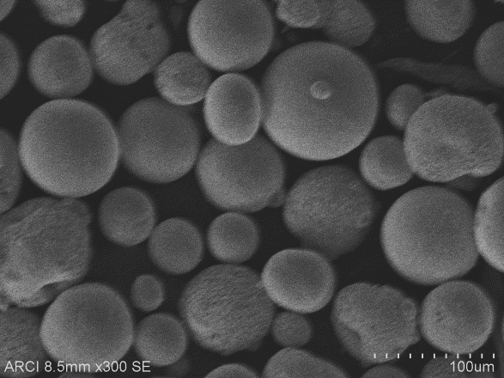
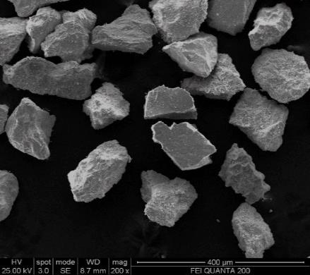
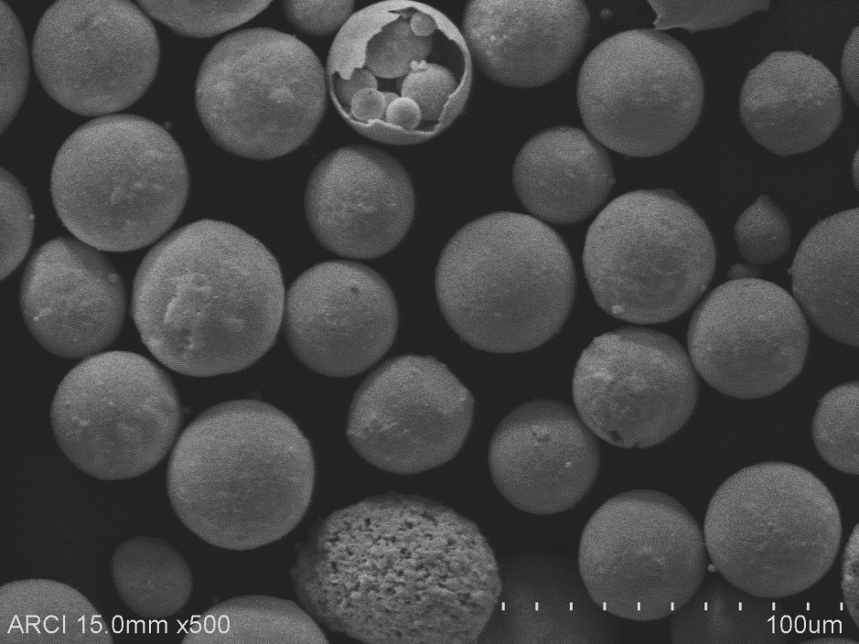
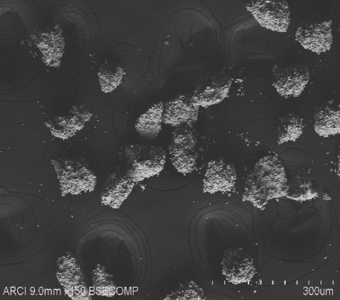
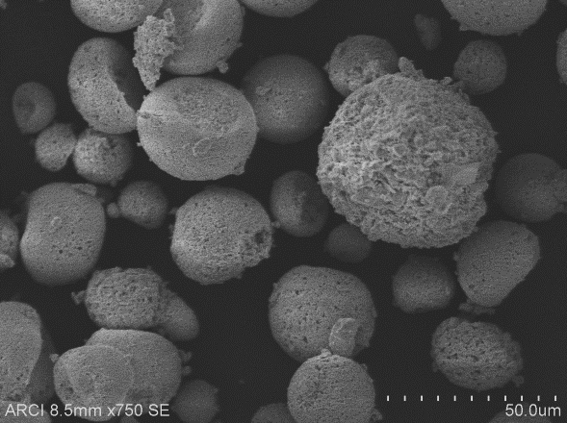
Candidate feedstock materials
Powder
Solution precursor
Y₂Zr₂O₇
Y₂Zr₂O₇
162.2 g Y(NO₃)₃.6H₂O +194.38ml Zr(CH₃COO)₄
Gd₂Zr₂O₇
147.8 g Gd(NO₃)₃.6H₂O +152.24ml Zr(CH₃COO)₄
Y₂O₃
339.2g Y(NO₃)₃.6H₂O
La₂Ce₂O₇
129.2g La(NO₃)₃.6H₂O + 129.61g Ce(NO₃)₃.6H₂O
La_{1.8}Gd_{0.2}Ce₂O₇
115.6g La(NO₃)₃.6H₂O + 128.9g Ce(NO₃)₃.6H₂O
13.4 g Gd(NO₃)₃.6H₂O
La₂Ce₂O₇
Gd₂Zr₂O₇*
La_{1.8}Gd_{0.2}Ce₂O₇
Y₂O₃
In-house synthesis
Commercial grades
* - Proprietary

Slide 24
Processing route
Deposition of RE zirconates directly over conventional bond coats yielded poor thermal cyclic performance due to low CTE (relative to BC), low toughness values and reactivity with TGO (formation of LaAlO₃ while applying La₂Ce₂O₇ over BC)
Double layered structure (top coat = REO + YSZ) is being evaluated
Composite APS + SPPS microstructure also being explored to improve CTE and toughening
Pressurized
precursor tank
Top coat- APS/SPPS
Top coat-SPPS+APS
Atomized
droplets
Top coat- APS
Bond coat
Bond coat
Plasma gun
Atomizer
Substrate
Substrate
Powder
Coating
Powder
injector
Substrate

Slide 25
Tasks accomplished so far
Optimization of process parameters for candidate feedstock materials - powders and solution precursors
Deposition of layered coatings comprising a CMAS resistant layer over conventional YSZ
Deposition of composite coatings involving CMAS resistant materials along with solution derived n-YSZ
Performance testing with CMAS –In progress

Slide 26
Plasma spraying of on Gd₂Zr₂O₇ : Parametric impact
500A
550A
600A
650A
Plasma power significantly influences the porosity, but not so much the phase content

Slide 27
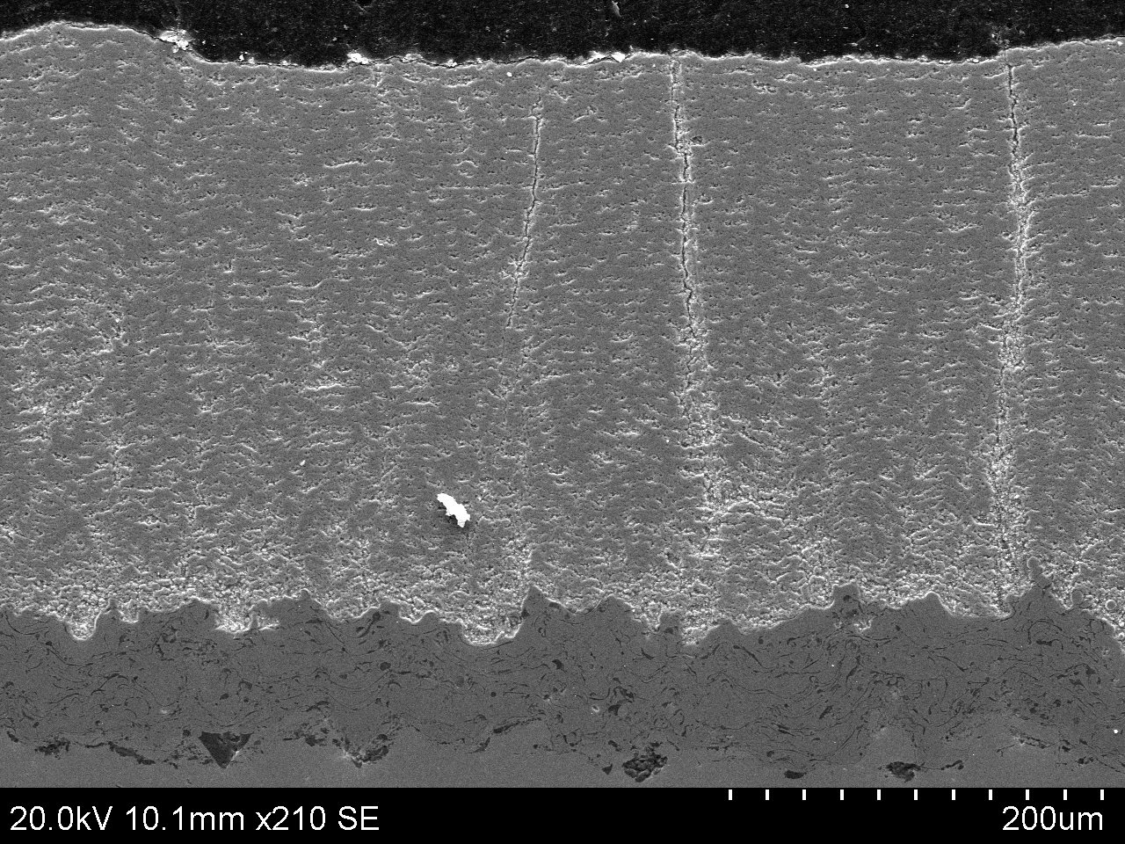
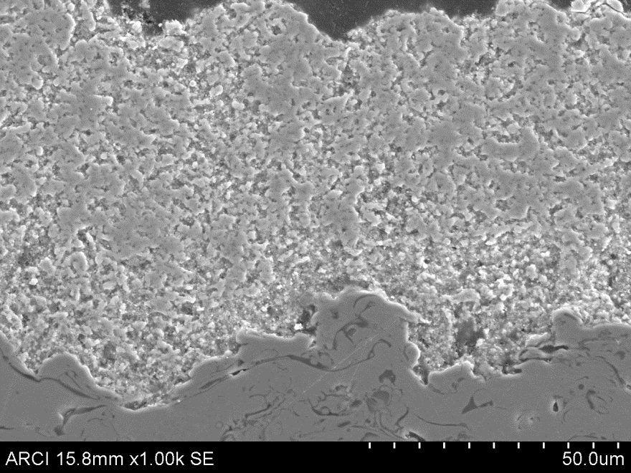
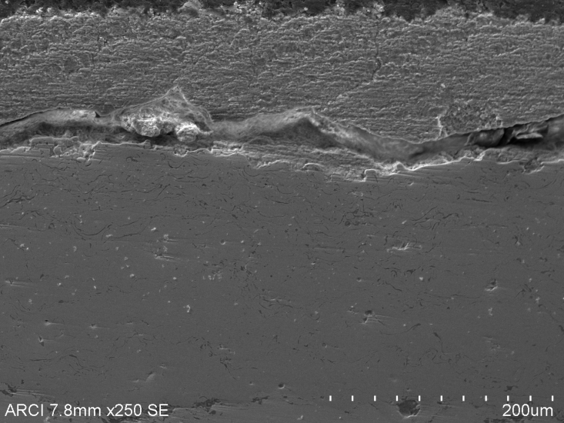
Optimized microstructures for CMAS resistant materials
APS
Solution precursor
Y₂Zr₂O₇
Y₂O₃-ZrO₂
La₂Ce₂O₇
Gd₂Zr₂O₇
Gd₂Zr₂O₇
La_{1.8}Gd_{0.2}Ce₂O₇
Y₂O₃
Y₂O₃
La₂Ce₂O₇
Detailed optimization based on phase contents and microstructural features
All powder based coatings were optimized
Formulation of precursor based on stoichiometry and concentration

Slide 28
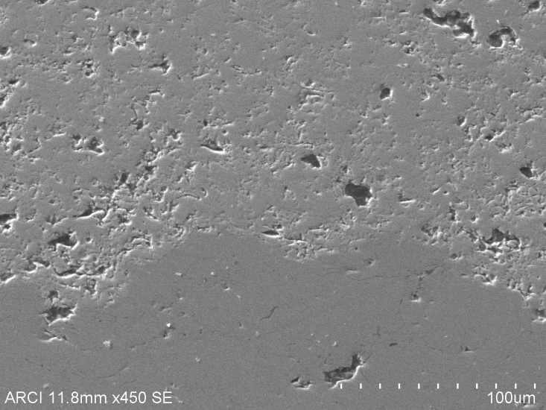
Double layer APS Y₂Zr₂O₇-YSZ
Y₂Zr₂O₇
Y₂Zr₂O₇
YSZ
YSZ
YSZ
NiCoCrAlY
NiCoCrAlY
Thick layers of optimized RE zirconate deposited over YSZ on bond coated C263 substrate
Top layer exhibits the preferred phase and expected to provide resistance to CMAS
Interlayer compatibility between the top coat layers

Slide 29
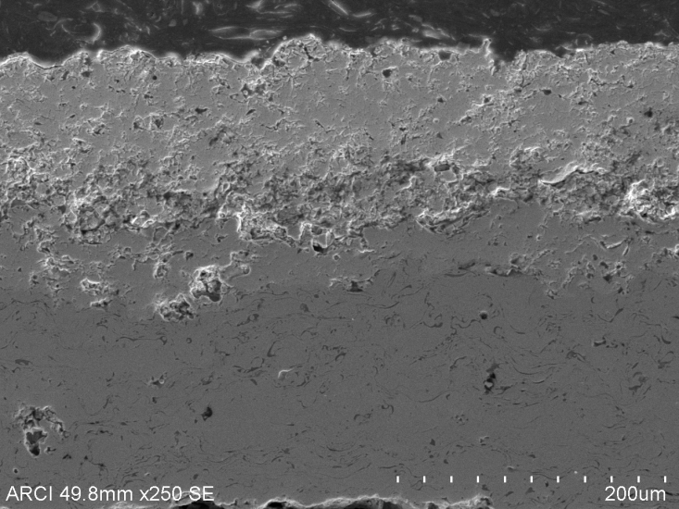
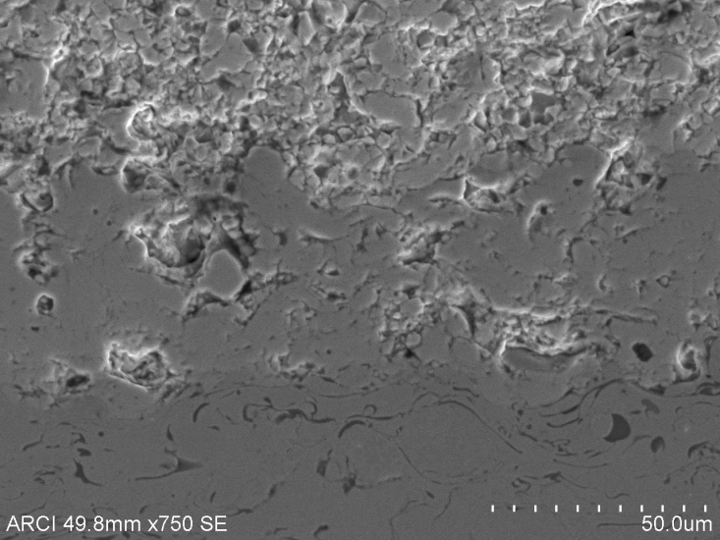
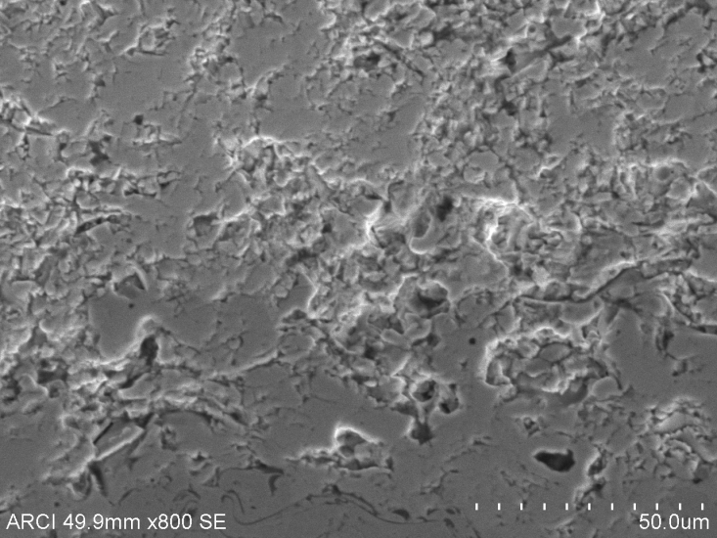
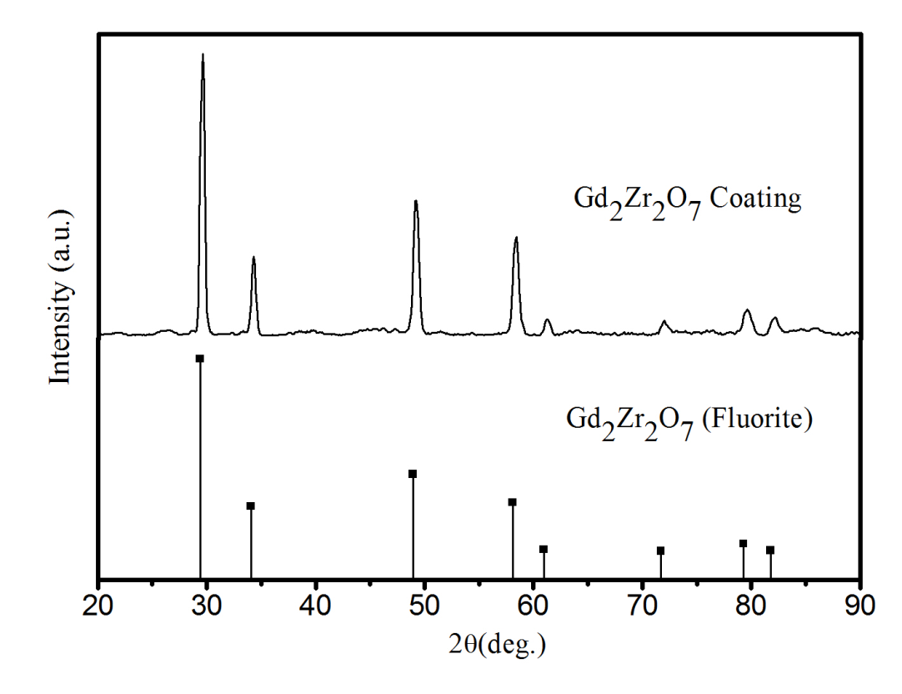
Double layer APS Gd₂Zr₂O₇-YSZ
Gd₂Zr₂O₇
Gd₂Zr₂O₇
Gd₂Zr₂O₇
YSZ
YSZ
NiCoCrAlY
YSZ
NiCoCrAlY
Single phased top layer of Gd₂Zr₂O₇ is known for the CMAS resistance
Interlayer compatibility between the top coat layers

Slide 30
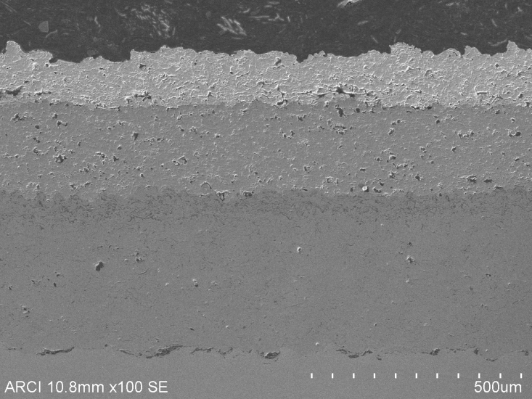
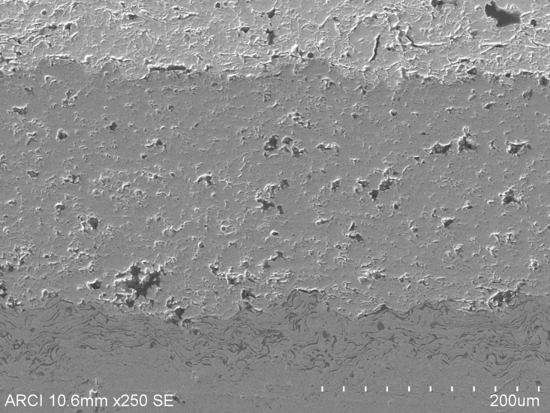
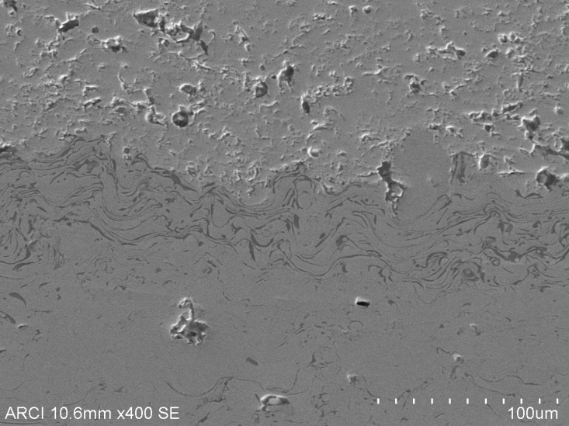
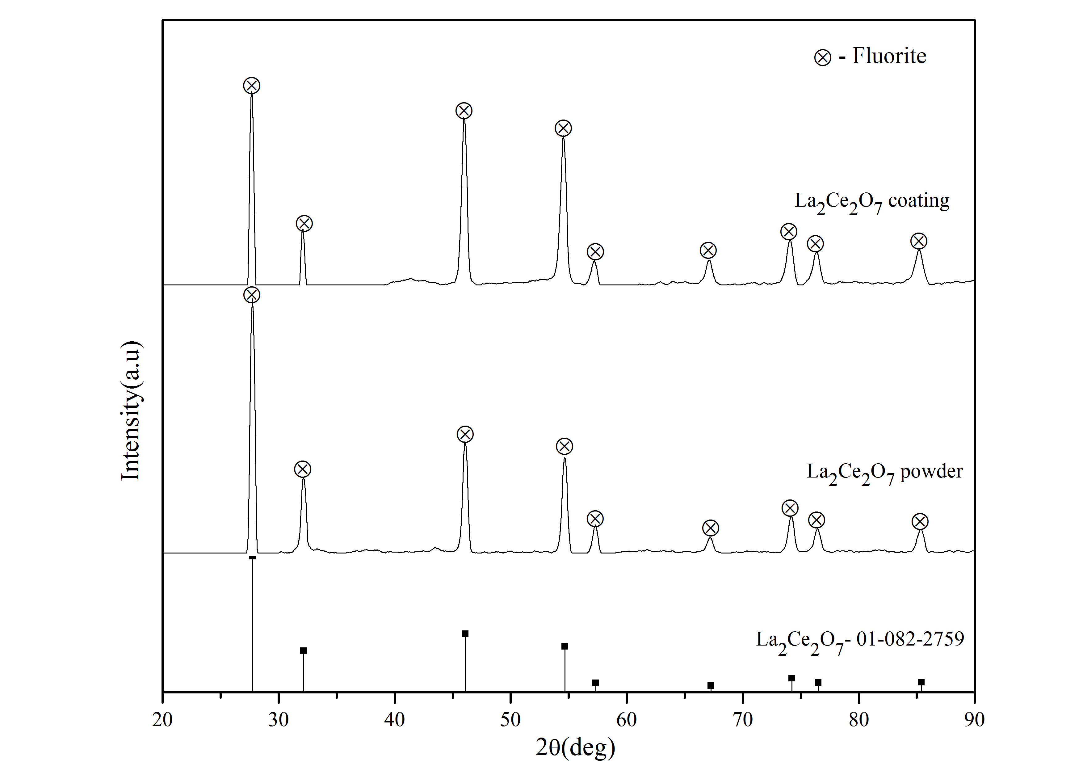
Double layer APS La₂Ce₂O₇-YSZ
La₂Ce₂O₇
YSZ
NiCoCrAlY
In-house synthesized La₂Ce₂O₇ with acceptable TBC characteristics shown good coatability as single or double layer

Slide 31
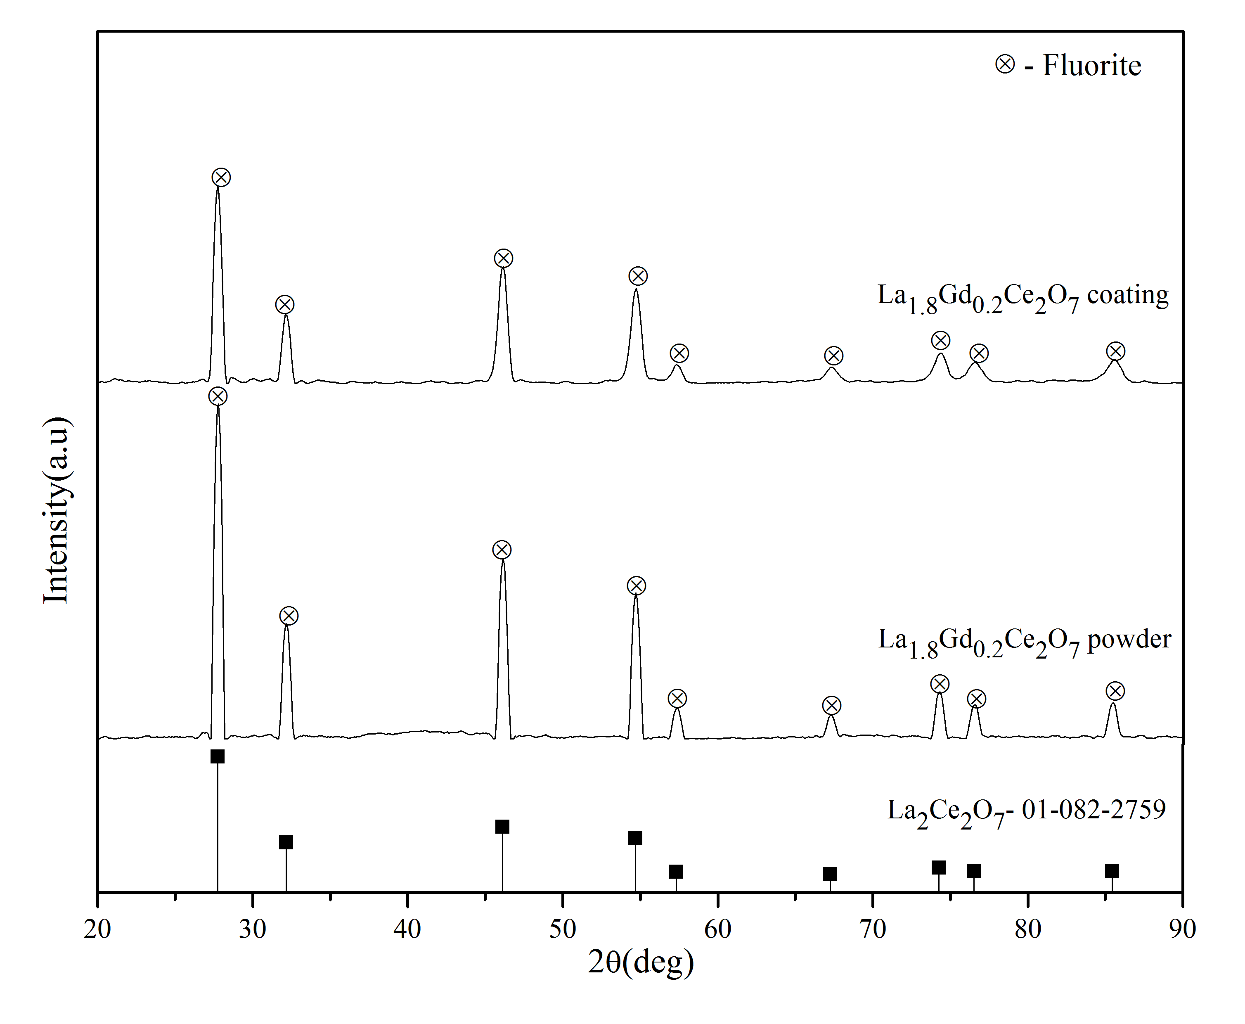
Double layer APS La_{1.8}Gd_{0.2}Ce₂O₇-YSZ
La_{1.8}Gd_{0.2}Ce₂O₇
La_{1.8}Gd_{0.2}Ce₂O₇
La_{1.8}Gd_{0.2}Ce₂O₇
YSZ
YSZ
YSZ
NiCoCrAlY
NiCoCrAlY
In-house synthesized La_{1.8}Gd_{0.2}Ce₂O₇ also shown good coatability as single or double layer
Effectiveness against CMAS is under evaluation

Slide 32
Development of Hybrid TBCs-Coating formation
Involves simultaneous injection of powders and solution precursor salts to form micron-sized powder and nanostructured features respectively, within the microstructure
Possibility of improved toughness, increase of CTE can be achieved with bimodal type of microstructures deposited through hybrid processing
Composite coatings prepared include Gd₂Zr₂O₇+ YSZ (S), Y₂Zr₂O₇ + YSZ (S), La₂Ce₂O₇ + YSZ (S), La_{1.8}Gd_{0.2}Ce₂O₇ + YSZ (S) coatings
JTST, 24 (7), 1166-1186, 2015

Slide 33
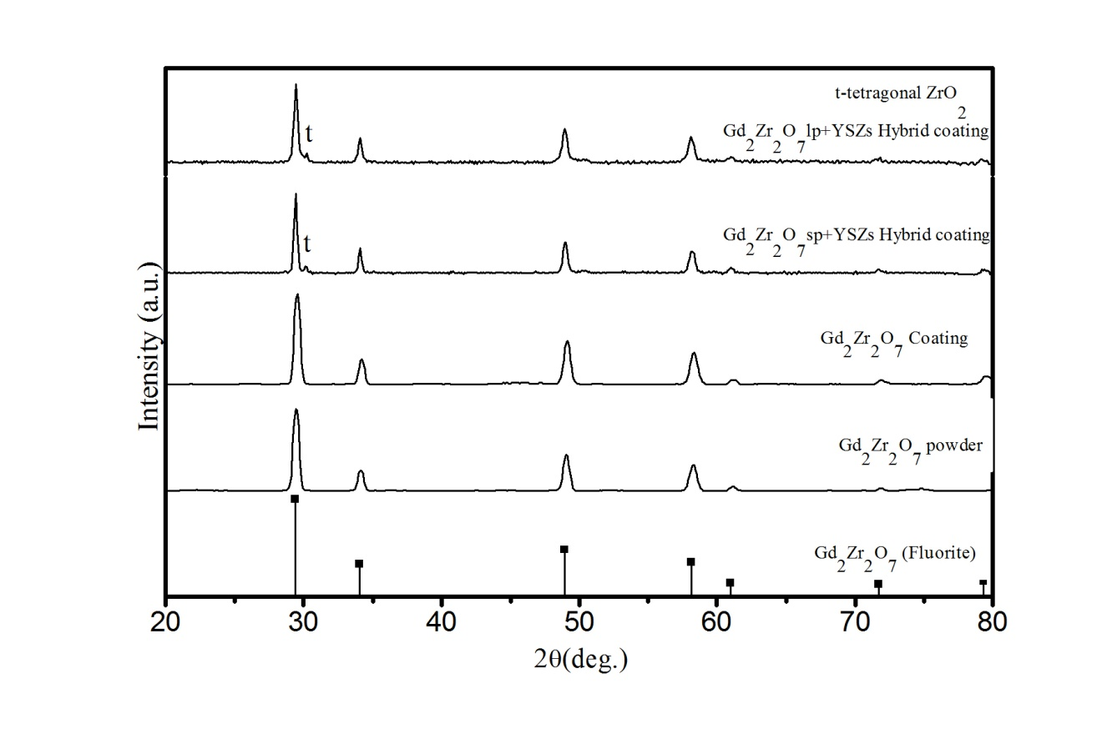
Composite Gd₂Zr₂O₇+YSZ
Composite Gd₂Zr₂O₇(P)+YSZ(S)
Introduction of nYSZ in composite Gd₂Zr₂O₇(P)+YSZ(S) improved the coating hardness as well as toughness

Slide 34
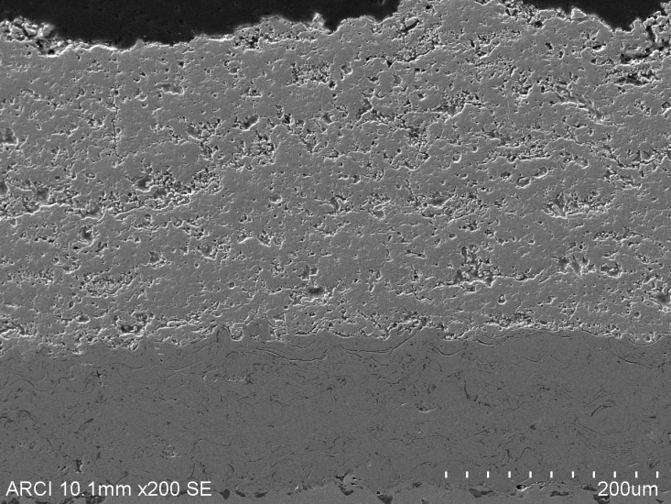
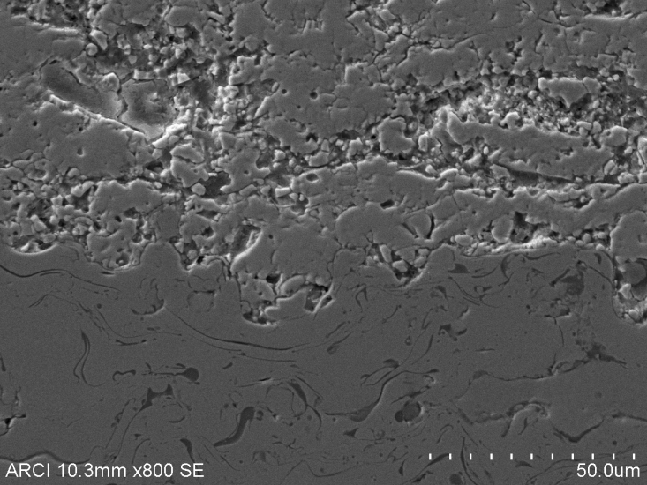
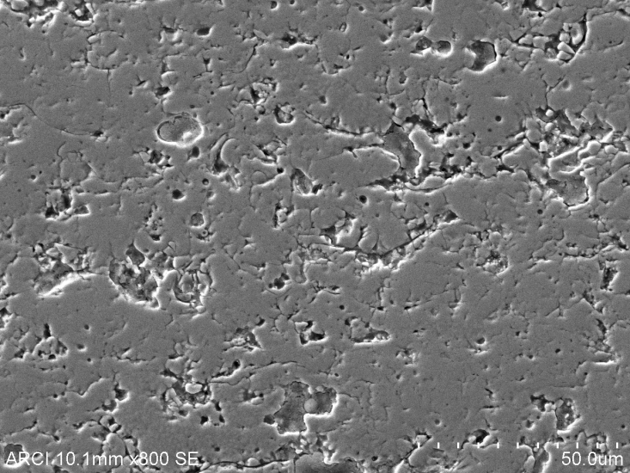
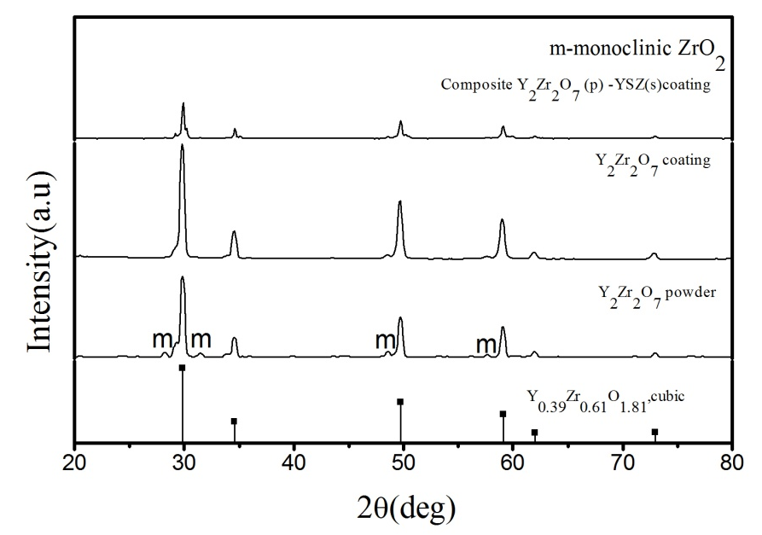
Composite Y₂Zr₂O₇+YSZ
Coatings with controlled porosity can be deposited

Slide 35
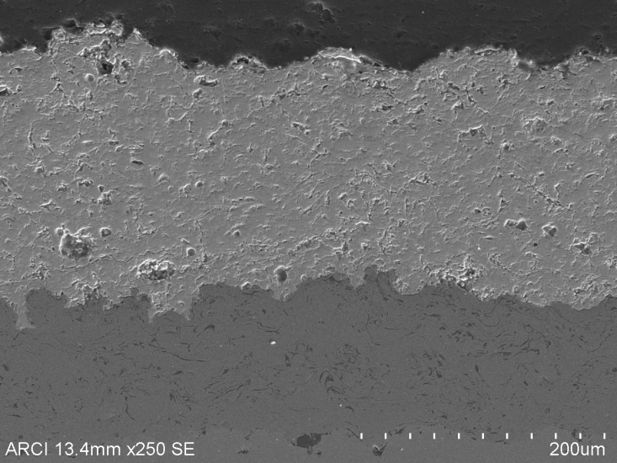
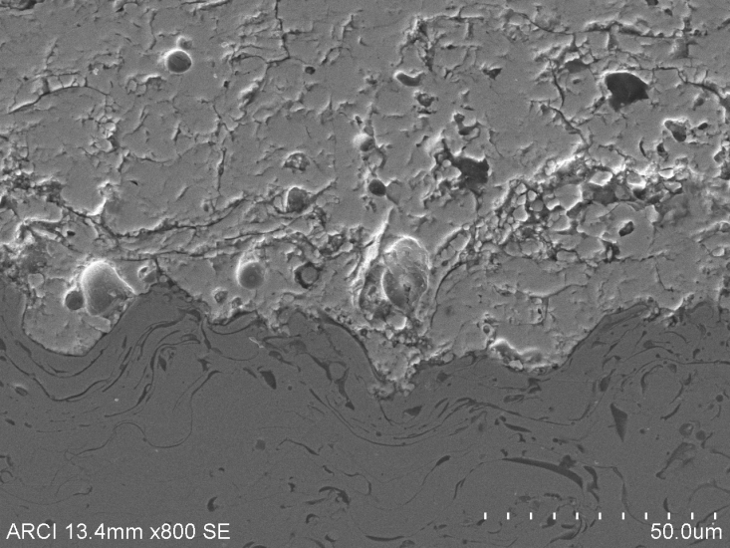
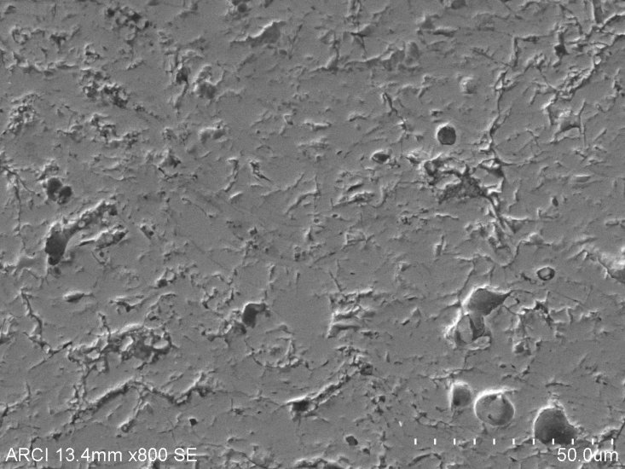
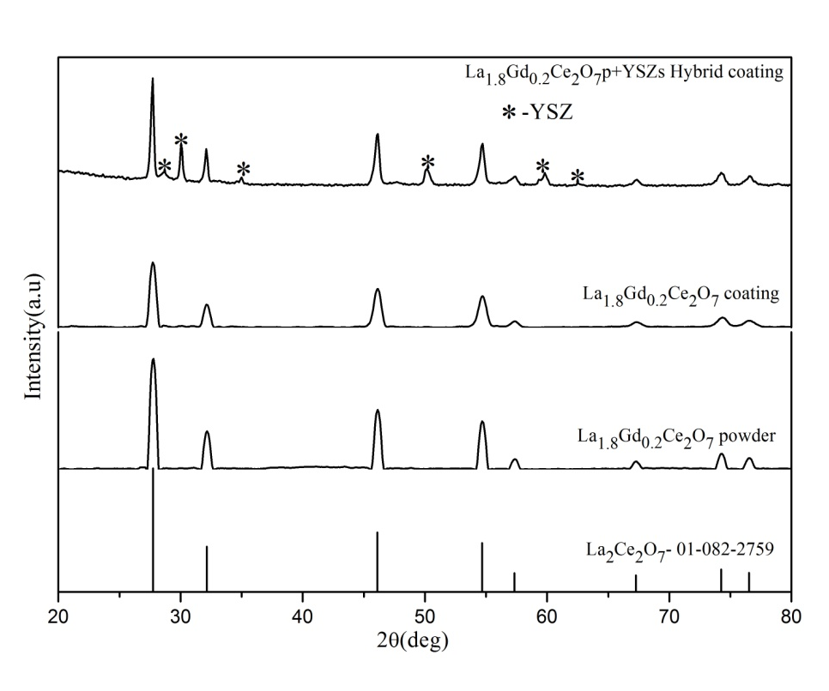
Composite (La_{x}Gd_{1-x})₂Ce₂O₇+YSZ
Optimized the composite coatings of (La_{x}Gd_{1-x})₂Ce₂O₇+YSZ with dual phase of fluorite and t’-ZrO₂

Slide 36
CMAS performance testing
Thermal cyclic studies with CMAS @ 1150ºC for various layered and composite coatings is in progress
Based on the preliminary evaluation, layered coatings of (La_{x}Gd_{1-x})₂Ce₂O₇-YSZ, Y₂Zr₂O₇ – YSZ and Gd₂Zr₂O₇ – YSZ appear to show relatively better resistance to spallation

Slide 37
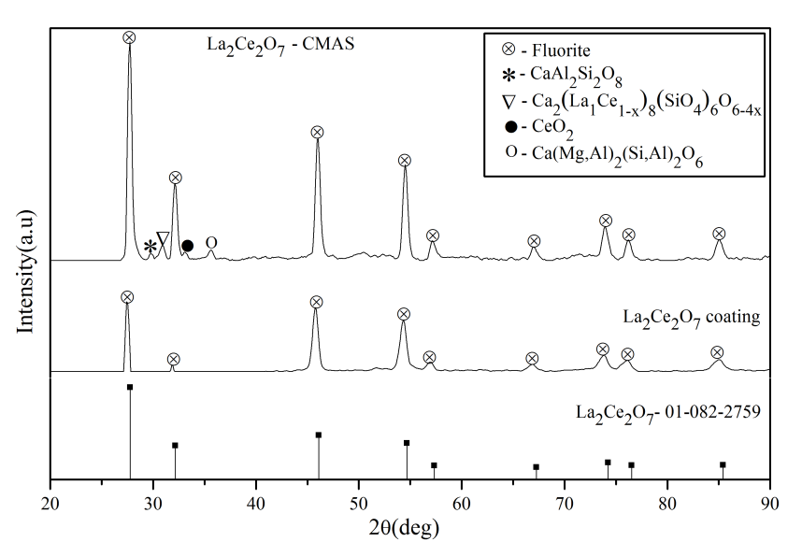
CMAS performance testing with DL SPPS REO-APS YSZ
Layered SPPS La₂Ce₂O₇-APS YSZ
Thermal cycled at 1150°C for 10 hrs (10 cycles) with Laki volcanic ash loading of 4 mg/cm²
Coating survived without any spallation after 10 cycles without any significant increase in density within YSZ layer
The layer of La₂Ce₂O₇ observed to prevent the infiltration of CMAS

Slide 38


Slide 39
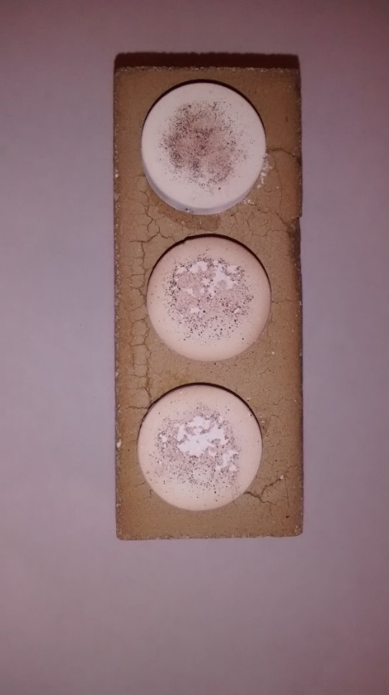
YSZ
GZ/YSZ
GZ dense/GZ/YSZ
Hekla Ash @ 1150ºC exposed for 1 hour (isothermal treatment)

Slide 40
Porosity content of the as sprayed TBCs was measured using 2 methods
Porosity values of the TBCs lie in the range of 18-22 Vol.%
Porosity measurement of the as sprayed TBCs

Slide 41
XRD analysis of GZ based TBCs showed a cubic defect fluorite structure
In the case of YSZ, a tetragonal prime phase was observed
XRD of the as sprayed TBCs

